Slide 1




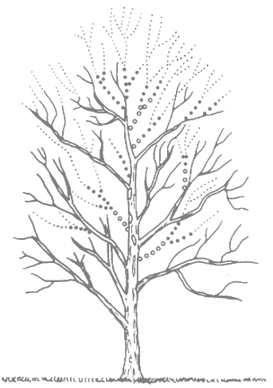
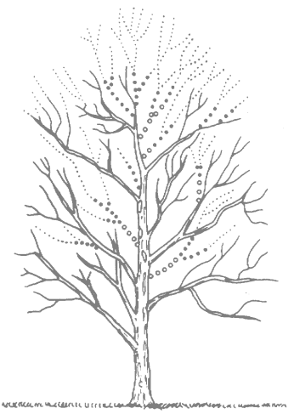
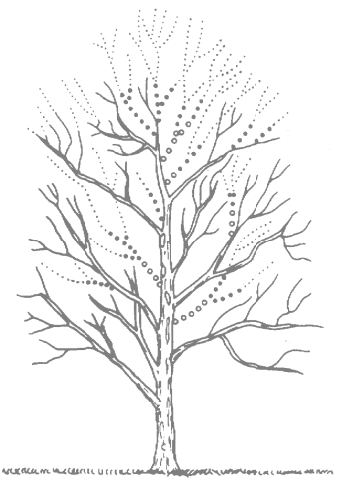
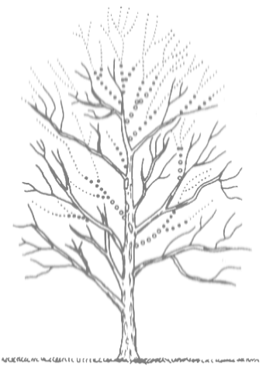
MSR Cambridge
Structured sparse Bayesian modelling for image registration
Loic Le Folgoc, Hervé Delingette, Antonio Criminisi, and Nicholas Ayache
Sparse Bayesian Registration of Medical Images for Self-Tuning of Parameters and Spatially Adaptive Parametrization of Displacements (Medical Image Analysis, 2016)
Quantifying registration uncertainty with structured sparse Bayesian modelling (Transactions on Medical Imaging, 2016)

Slide 2
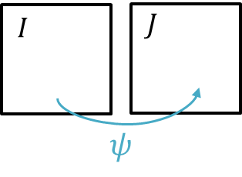
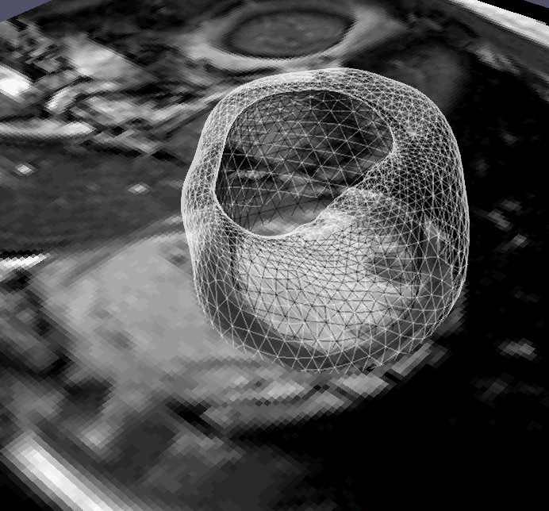
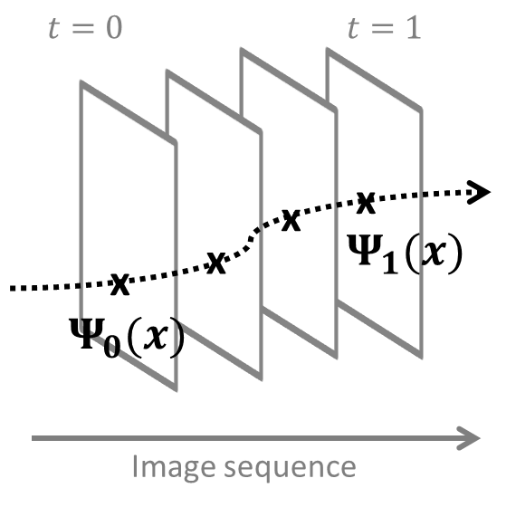
Motivation: Cardiac motion tracking
Task
Challenges
Changing organ appearance: membranes, trabeculae
Imaging artefacts
Large 3D(+t) volumes
Aperture problem / ill-posedness
Multi-scale representation? Accuracy /robustness trade-off?
Uncertainty quantification?
Notes:
Cardiac motion tracking. Motion tracking = track the trajectories of physical points over time, the intuition is that the motion carries a lot of information about how healthy the heart is. Interest in quantifying uncertainty in the estimated motion to make use of this downstream.

Slide 3
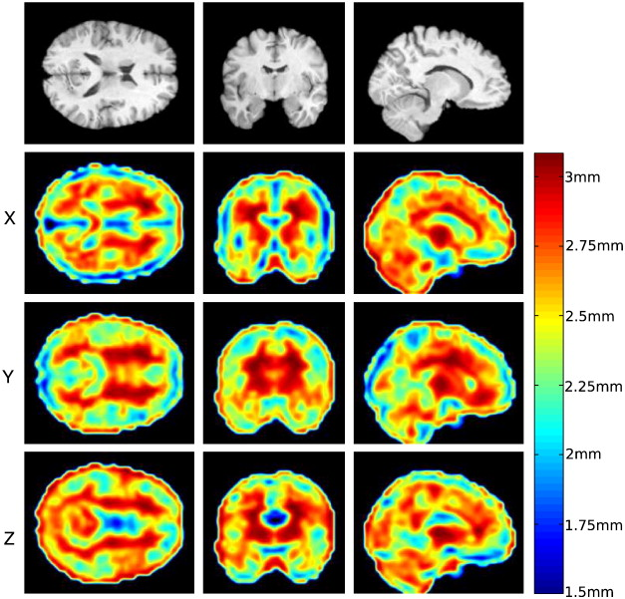
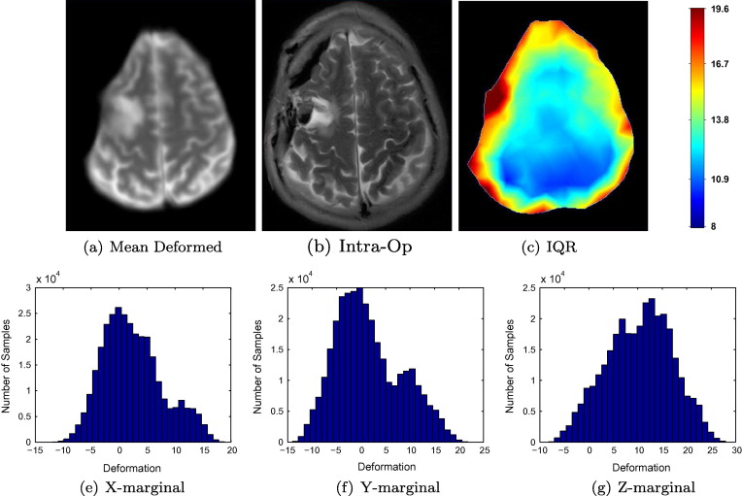
State-of-the-art on Bayesian registration
Simpson et al. (NeuroImage 2012, MedIA 2015)
Large parametric representation
Variational Bayes approach
Risholm et al. (MedIA 2013)
Finite-element discretization
MCMC characterization
Computational challenge: high dimensional representation of transformation
Modelling challenge: faithful statistical model of image data

Slide 4
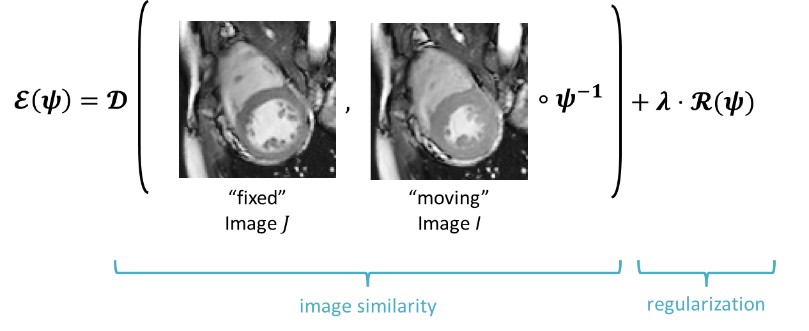
Image registration revisited

Slide 5

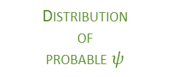

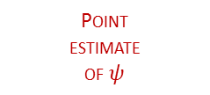
Image registration revisited
Optimization view
Probabilistic view
$$ψ^{∗}=\underset{ψ}{argmin}{ℰ(ψ)}$$
$$p\left(ψ\right)∝\exp{−ℰ(ψ)}$$
Manually
tuned
parameters
Non
generative
model
Point
estimate
of $ψ$
Inferred
parameters
Generative
Model
Distribution
of
probable $ψ$

Slide 6
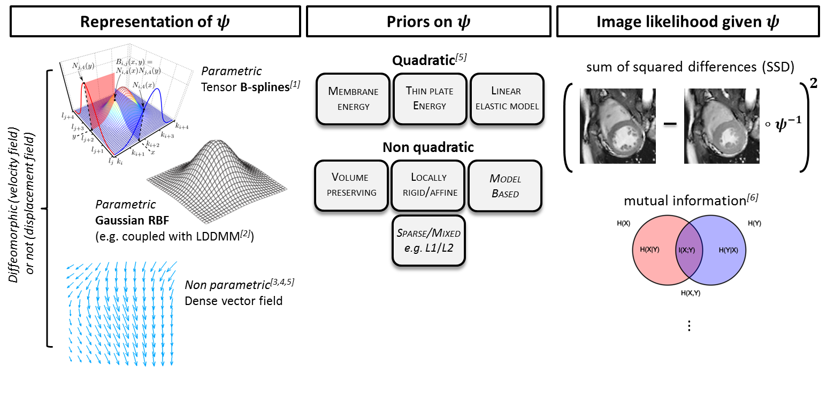
Bayesian image registration: building blocks
[1] Rueckert et al. (TMI 1999)
[3] J.-P. Thirion (MedIA 1998)
[6] Wells et al. (MedIA 1996)
[2] Durrleman et al.(MICCAI 2007)
[4] Arsigny et al. (MICCAI 2006)
[7] Survey in Sotiras et al. (TMI 2013)
[5] Ashburner (NeuroImage 2007)

Slide 7
Bayesian image registration: building blocks
“small displacements” & Gaussian RBFs
structured spike-&-slab
Gaussian Mixture Model

Slide 8
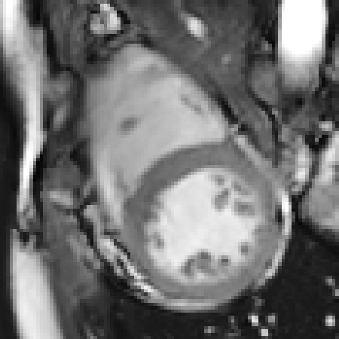
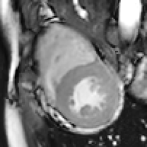
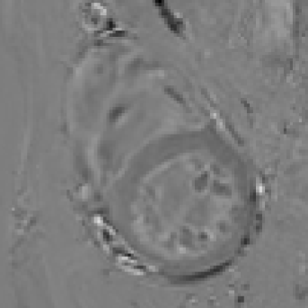
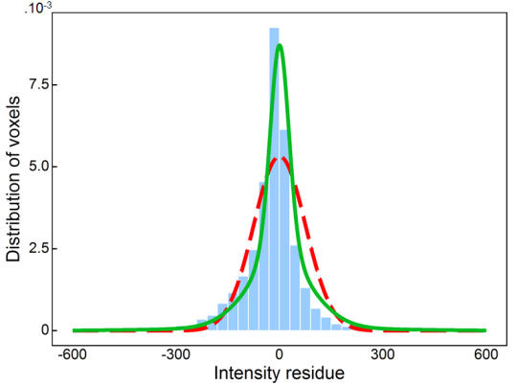
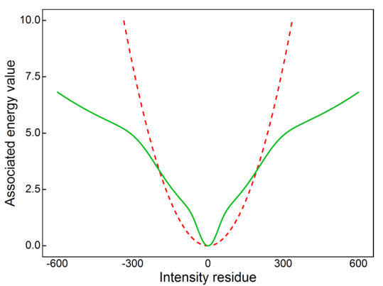
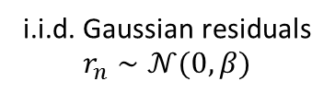
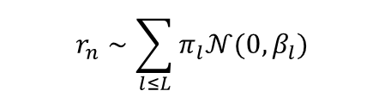
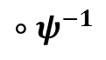
Image noise: Gaussian Mixture Model
$$∘ψ^{−1}$$
“fixed” image
“warped” image
residual image
SSD model
GM model
histogram of residuals
energy of residual

Slide 9
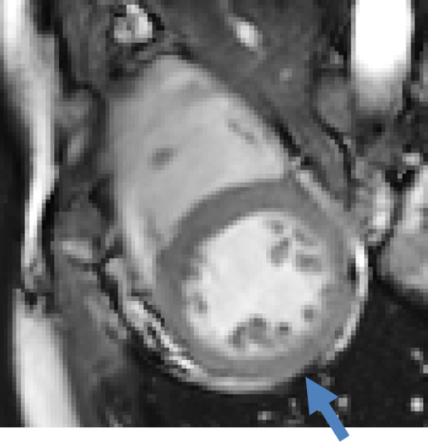
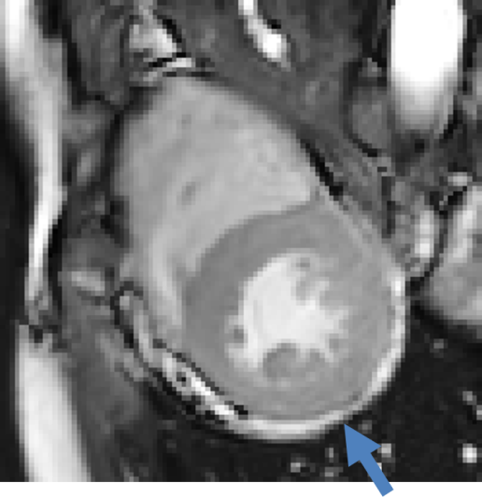
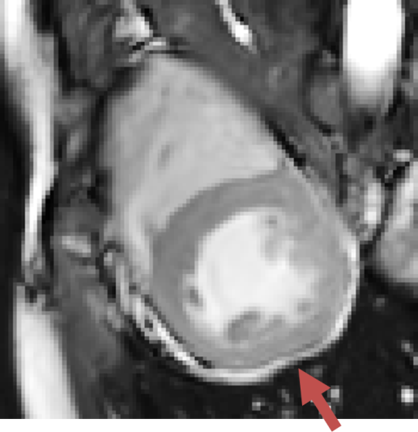
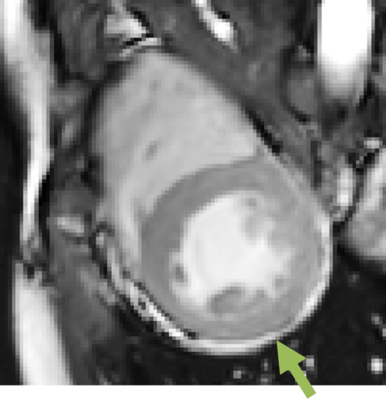
Image noise: Gaussian Mixture Model
fixed image
moving image
SSD warped image
GMM warped image
SSD model
GM model
histogram of residuals
energy of residual

Slide 10
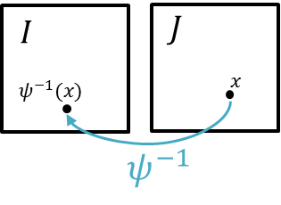

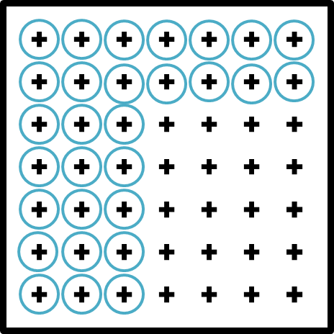
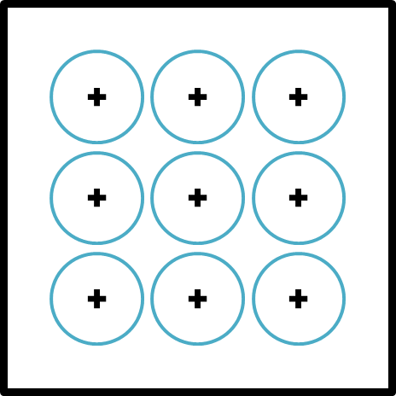
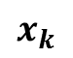
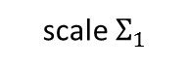
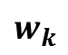
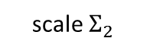
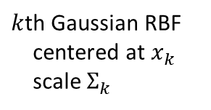
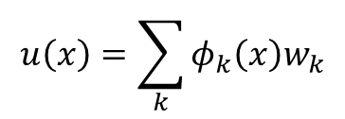


Representation of displacements $u≜ ψ^{−1}−Id$
$$u\left(x\right)=\sum_{k}{φ_{k}\left(x\right)w_{k}}$$
basis weight
$k$th Gaussian RBF
centered at $x_{k}$
scale $Σ_{k}$
multiscale dictionary ${\left\{φ_{k}\right\}}_{k=1…M}$
scale $Σ_{1}$
$$w_{k}$$
scale $Σ_{2}$
$$x_{k}$$
$$⋱$$

Slide 11
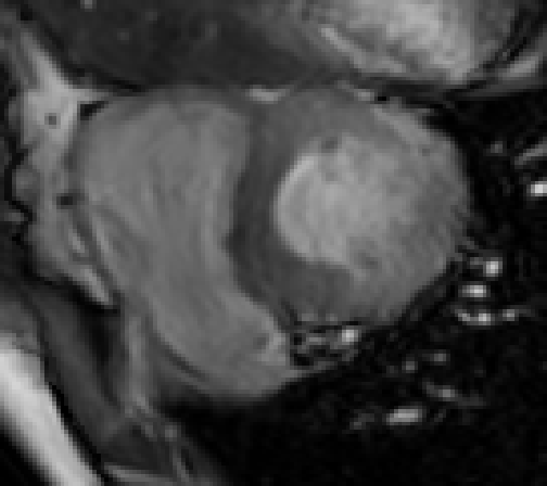
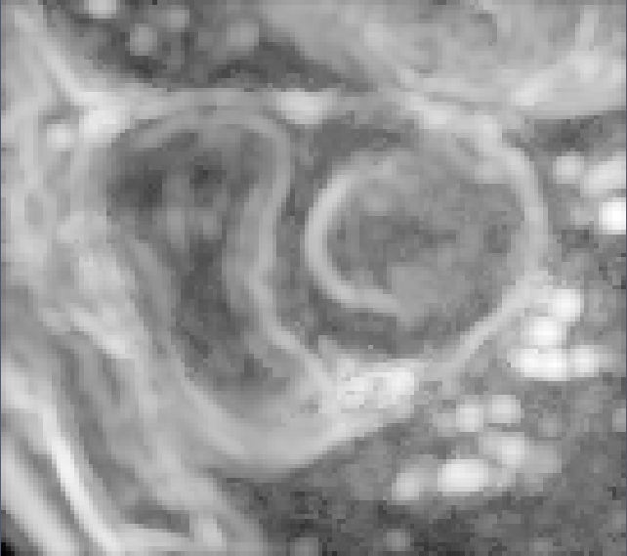
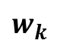

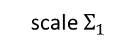
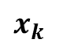
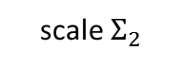
Representation of displacements $u≜ ψ^{−1}−Id$
$$u\left(x\right)=\sum_{k}{φ_{k}\left(x\right)w_{k}}$$
multiscale dictionary ${\left\{φ_{k}\right\}}_{k=1…M}$
why multiscale?
scale $Σ_{1}$
$$w_{k}$$
scale $Σ_{2}$
$$x_{k}$$
$$⋱$$
original image
“structured” content
Principled strategy to automatically select the best (local) scale?

Slide 12
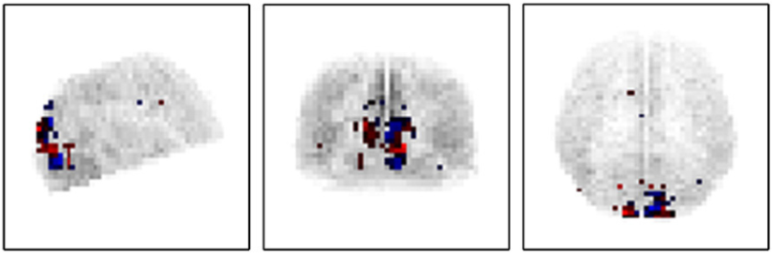
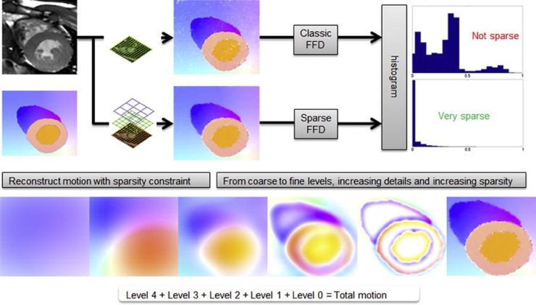
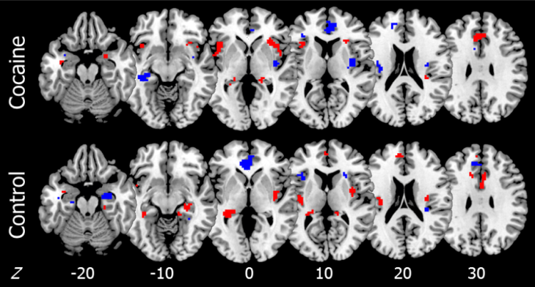
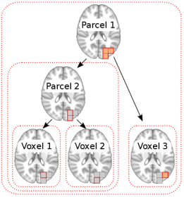
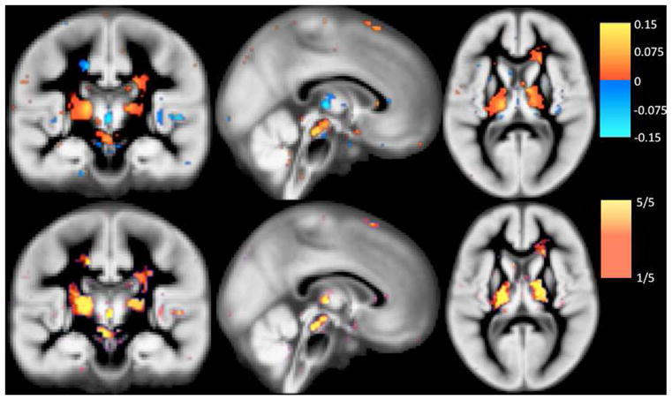
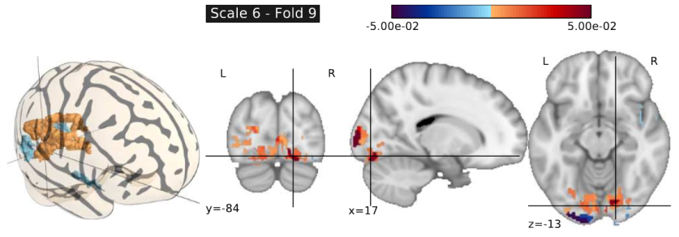
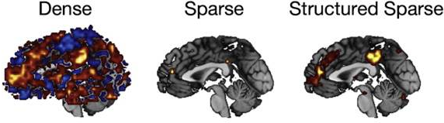
Sparse structured priors in medical imaging
Convex norms (weakly sparse): Elastic Net & extensions
Bayesian priors & ARD
k-support norms for fMRI CART
Belilovsky et al. (CMIG 2015)
Structured Gaussian-Gaussian mixture prior for Bayesian logistic regression
van Gerven (NeuroImage 2010)
L1/L2 regularization for registration
Shi et al. Sparse FFD (MedIA 2013)
L1/L2 regularization for brain prediction
Grosenick et al. GraphNet (NeuroImage 2013)
Hierarchical structured sparsity for fMRI CART
Jenatton et al. (SIIMS 2012)
Structured sparse Bayes/ARD for classification & regression
Sabuncu et al. RVoxM (TMI 2012)

Slide 13
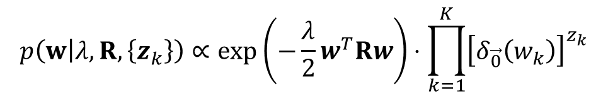
Sparsity- and smoothness-inducing prior on transformation parameters $w_{k}$
$$p\left(w | λ, R,\left\{z_{k}\right\}\right)∝\exp\left(−\frac{λ}{2}w^{T}Rw\right)⋅\prod_{k=1}^{K}{{\left[δ_{\vec{0}}\left(w_{k}\right)\right]}^{z_{k}}}$$

Slide 14
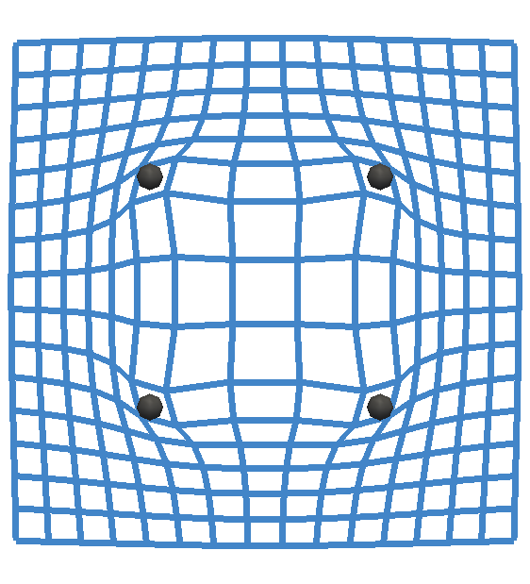
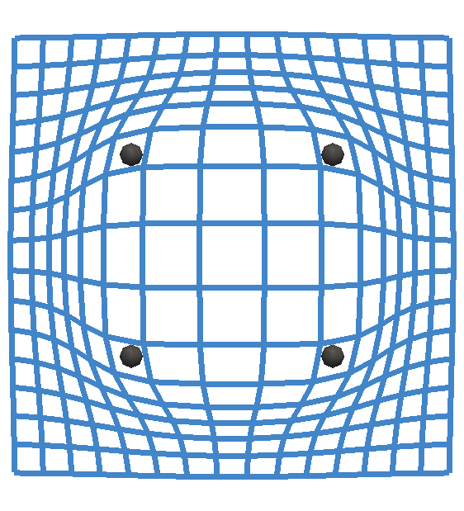





Sparsity- and smoothness-inducing prior on transformation parameters $w_{k}$
$$p\left(w | λ, R,\left\{z_{k}\right\}\right)∝\exp\left(−\frac{λ}{2}w^{T}Rw\right)⋅\prod_{k=1}^{K}{{\left[δ_{\vec{0}}\left(w_{k}\right)\right]}^{z_{k}}}$$
smoothing
$R$ structured matrix
$$R_{kl}=〈Dφ_{k}|Dφ_{l}〉$$
elastic membrane
$$D=∇$$
thin plate
$$D=∇^{2}$$
Ashburner et al. (2013)

Slide 15



Sparsity- and smoothness-inducing prior on transformation parameters $w_{k}$
$$p\left(w | λ, R,\left\{z_{k}\right\}\right)∝\exp\left(−\frac{λ}{2}w^{T}Rw\right)⋅\prod_{k=1}^{K}{{\left[δ_{\vec{0}}\left(w_{k}\right)\right]}^{z_{k}}}$$
smoothing
$R$ structured matrix
sparsity inducing
$$z_{k}=1⇒w_{k}=0$$
$$z_{k}=0⇒w_{k}∈ℝ$$
$p(w|λ,R)$ for $z_{k}∼Bernoulli(1/2)$
High proba.
Low proba.
Mitchell and Beauchamp’s
Spike & Slab (1988)

Slide 16
Sparsity- and smoothness-inducing prior on transformation parameters $w_{k}$
$$p\left(w | λ, R,\left\{z_{k}\right\}\right)∝\exp\left(−\frac{λ}{2}w^{T}Rw\right)⋅\prod_{k=1}^{K}{{\left[δ_{\vec{0}}\left(w_{k}\right)\right]}^{z_{k}}}$$
smoothing
$R$ structured matrix
sparsity inducing
$$z_{k}=1⇒w_{k}=0$$
$$z_{k}=0⇒w_{k}∈ℝ$$
$p(w|λ,R)$ for $z_{k}∼Bernoulli(1/2)$
High proba.
Low proba.
Mitchell and Beauchamp’s
Spike & Slab (1988)

Slide 17






Variational Bayes inference
Maximize the lower-bound $ℒ(q)$
Efficient generalized VBEM & active set strategy for the variational family:
High-level algorithm
Greedily add/remove basis functions to the active set and update $q(w|\hat{z})$ in closed-form
Update noise and regularization hyperparameters in closed form
Laplace approximation of the data likelihood around mode of true posterior
$→$ “classic” energy minimization w.r.t. active basis functions
Extends Tipping et al.
Relevance Vector Machine

Slide 18






A greedy scheme: progress across iterations
$1$ circle $=$ 1 basis
Iteration $60$
Iteration $250$

Slide 19







Experiments & results: $3D+t$ cine MRI
$15$ test sequences
$$∼1.25mm×1.25mm×8mm$$
$30$ frames/sequence
$∼20$min/frame
Variability of inferred hyperparameter $λ$
(pooled statistics over dataset)
Discrepancy between reference mesh propagated
by registration and direct $4D$ segmentation

Slide 20






Experiments & results: $3D+t$ tagged MRI
$15$ sequences
$$∼1mm×1mm×1mm$$
$20−30$ frames/sequence
$∼30$min/frame
Benchmark (Tobon-Gomez et al. 2013): manually placed landmarks ($12$/frame/obs., all frames, $2$ observers)
State-of-art accuracy (pooled statistics)
Reduced parametrization (pooled statistics)

Slide 21


Experiments & results: $3D+t$ tagged MRI
$15$ sequences
$$∼1mm×1mm×1mm$$
$20−30$ frames/sequence
$∼30$min/frame
Benchmark (Tobon-Gomez et al. 2013): manually placed landmarks ($12$/frame/obs., all frames, $2$ observers)
State-of-art accuracy (pooled statistics)
Consistent projected strain maps (Cauchy-Green)

Slide 22



What about uncertainty estimates?
Confidence intervals efficiently obtained from the variational marginal distribution $q\left(w\right)=𝒩(μ, Σ)$
Can we trust these estimates?
Below: displacement uncertainty at end-systole, volume uncertainty over time
Displacement uncertainty:
Cardiac volume uncertainty:

Slide 23




Sparse Bayesian registration: graphical model
$Ψ$ transformation
$φ_{k}$ basis function
$w_{k}$ basis weight
$z_{k}$ activation variable
$λ$ regularity parameter
$𝒟$ image data
$P$ mixture parameters
Characterize $p\left(w | 𝒟\right)$

Slide 24




One model, two inference strategies
Posterior: $p\left(w | 𝒟\right)=\int{p\left(w | 𝒟,θ\right)p\left(θ | 𝒟\right)dθ}$
Evidence-based inference
Exact inference
$p(θ|𝒟)≈δ_{θ^{∗}}(θ)$ “peaked”
$$p(w|𝒟)≈p(w|𝒟,θ^{∗})$$
Characterize $p(w|𝒟)$
(no closed-form $→$ MCMC)
Consistency between approximate and exact inference?

Slide 25

MCMC scheme: main constituents
[1] Green and Hastie. Reversible jump MCMC computation and Bayesian model determination (Biometrika 1995)
[2] Grenander and Miller. Representations of Knowledge in Complex Systems (J. R. Stat. Soc. 1994)

Slide 26

Exact vs. fast VBEM inference: 1D regression example

Slide 27

Exact vs. fast VBEM inference: 1D regression example
Fast inference: expectation consistent but not predictive uncertainty^{[1]}
With exact inference $→$ sparse Bayesian model gives sensible predictions
[1] Rassmussen et Candela (ICML 2005)

Slide 28




exact mean vs. Evidence-based mean
fixed
moving
Evidence-based mean
MCMC mean

Slide 29

Empirical mixing of the markov chain
fixed
moving
MCMC mean
(Gibbs sampling)
MCMC mean
(nuisance variables marginalized)

Slide 30



Example MCMC samples
fixed
moving
Three samples

Slide 31




MCMC summary statistics
fixed
moving
color scheme: direction of largest eigenvector
displacement
standard deviation
directional spread of uncertainty (tensor)

Slide 32



Summary: sparse Bayesian modelling for image registration
Advantages
Limitations
Adaptive, multiscale, compact parametrization
Automated tuning of parameters
(alternative to unfeasible/costly cross-validation)
VBEM tractable on $3D$ or $3D+t$ real images
Clear definition of uncertainty
MCMC can help improve VBEM
Hyperparameter inference sensitive to modelling errors
VBEM: complex implementation, RAM footprint
MCMC: highly technical, efficient parallelization required for 3D
To do
diffeomorphic extension, temporal constraints…

Slide 33
MSR Cambridge
Thank you!

